Slide 1
GE DOCUMENTATION
2014 Leadership Meeting

Slide 2
Objectives:
To be able to locate and download GE documentation into your PC
Understand how GE documents are organized and how to look for information
Learn how to find the acronyms list
Become familiar with the parts manual
To gain a basic knowledge of the magnet documentation

Slide 3
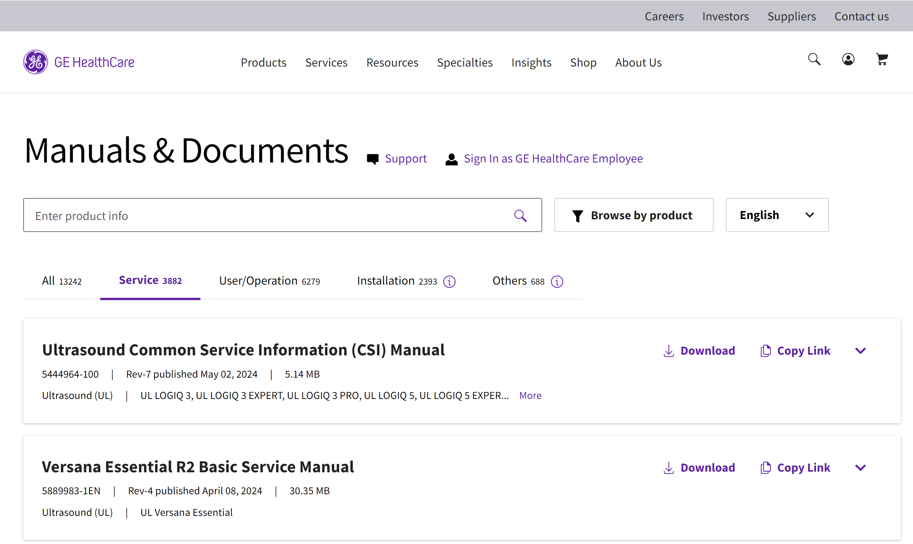
GE support website
Manuals | GE HealthCare (United States)

Slide 4
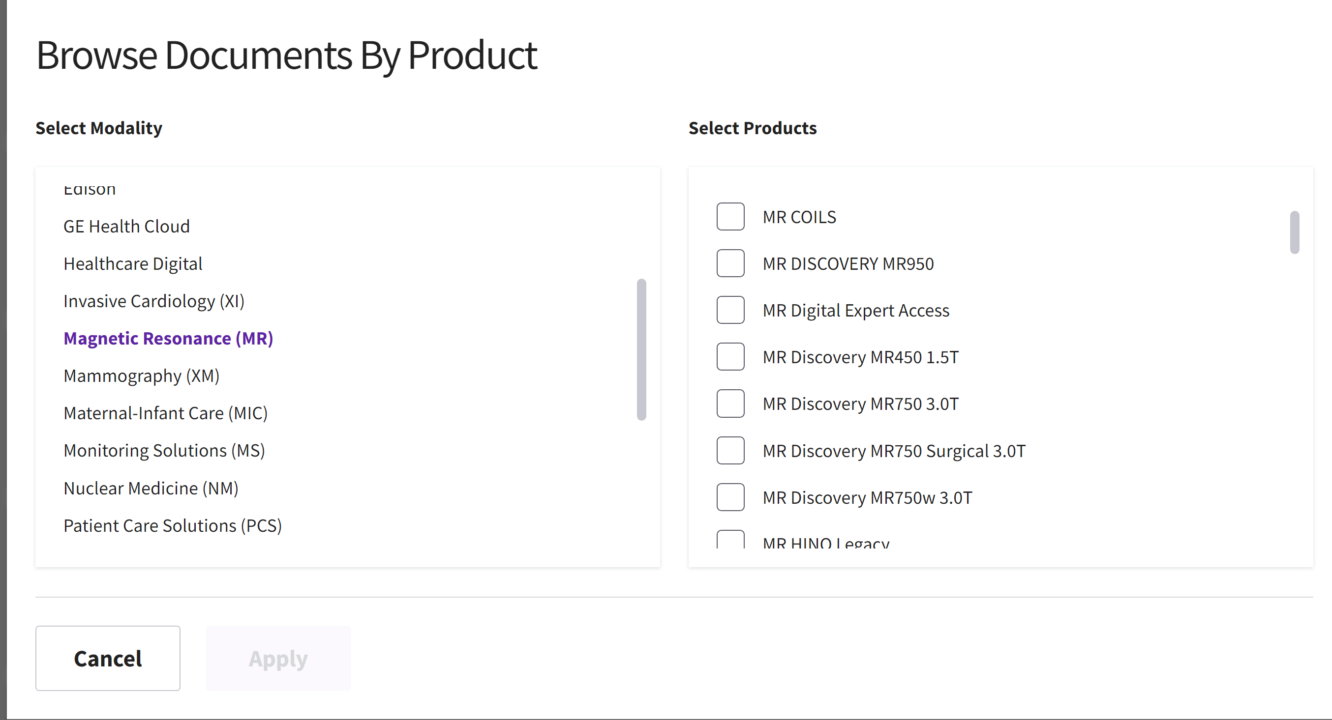
Service Manuals
Click in the Magnetic Resonance section to unfold the list of MR systems.
Click on the desired product

Slide 5
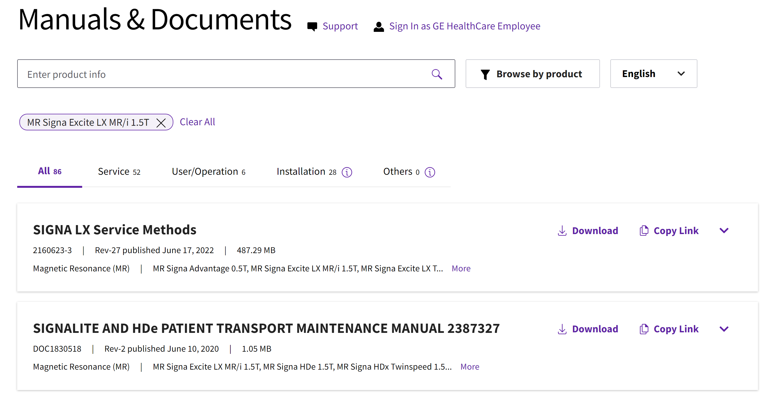
Service Documents
Most of the time we will be looking for the Service Methods CD and will download as a .zip or .pdf filename.

Slide 6
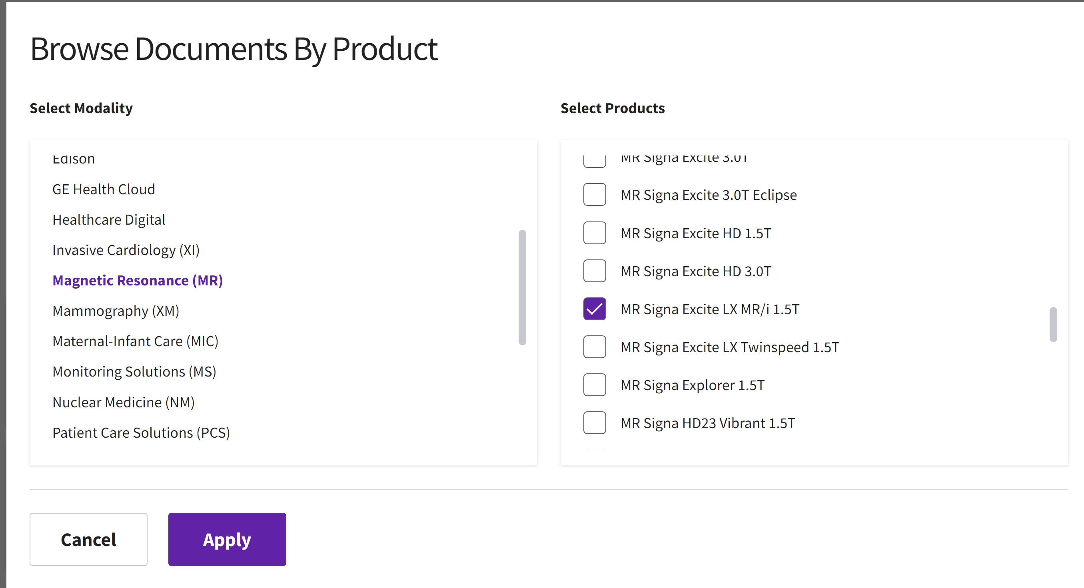
Service Documents
As an example, I have chosen Signa Excite LX

Slide 7
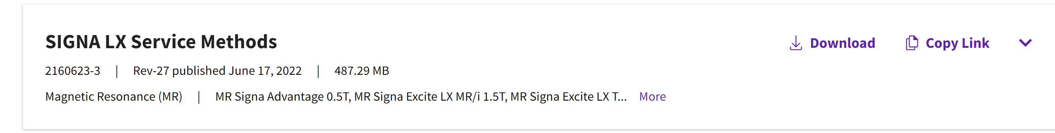
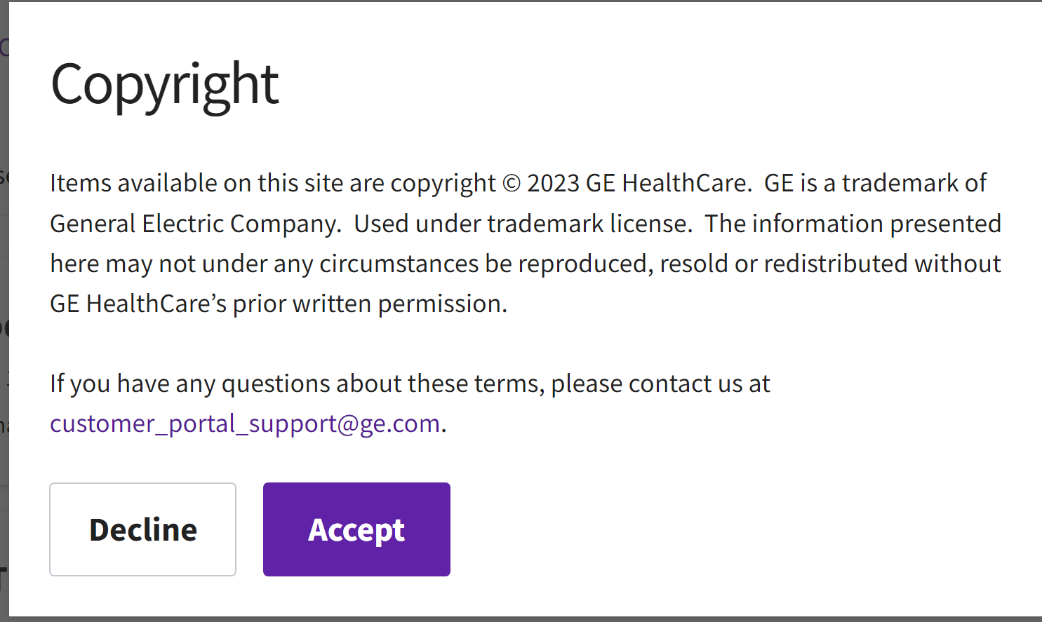
Service Documents
Find the manuals you want to download
Click on ‘Download’ then ‘Accept’ to start downloading

Slide 8
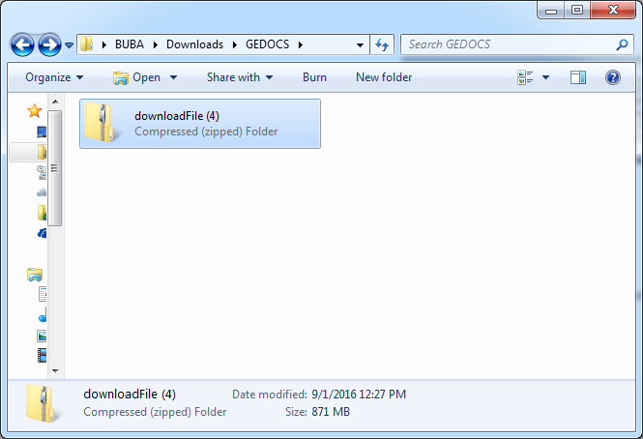
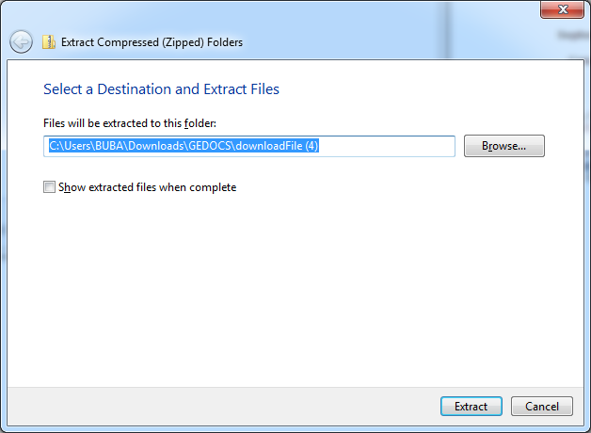
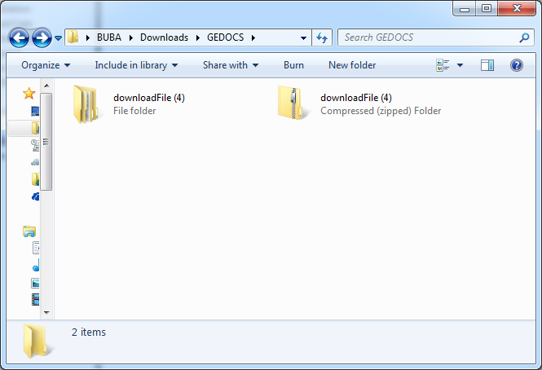
Service Documents
Unzip the downloaded file if necessary

Slide 9
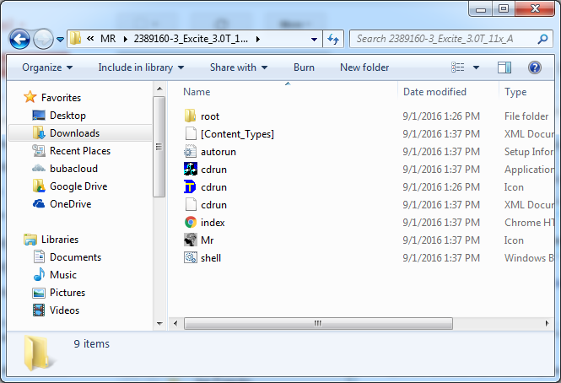
Service Documents
The final result for a Service Methods CD-ROM should look like this always:

Slide 10
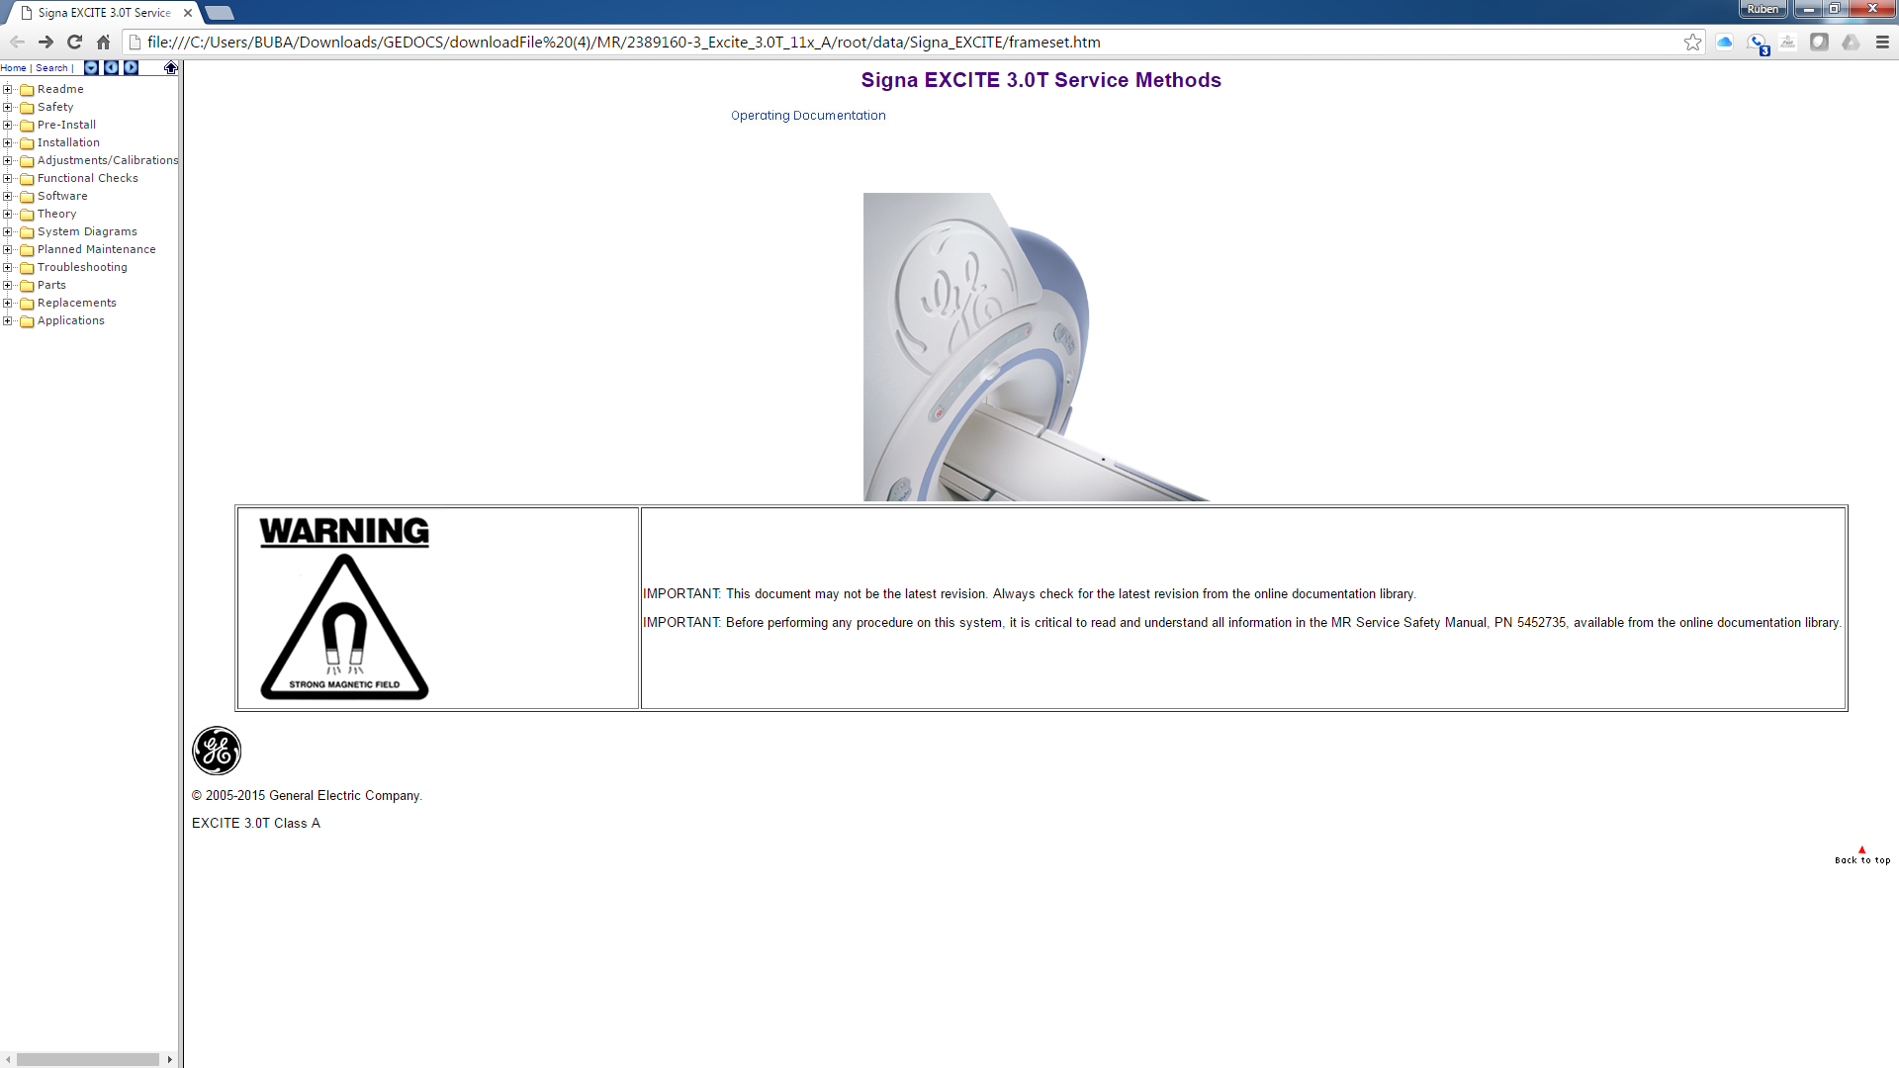
Service Documents
The index.html will open the main menu contents in the browser of your choice.

Slide 11
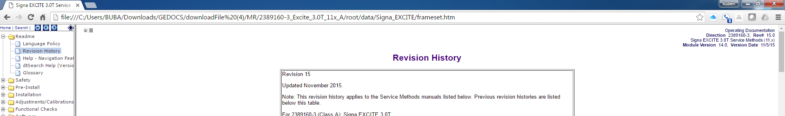
Service Documents
The Revision History under Readme gives you the date and revision you are looking at.

Slide 12
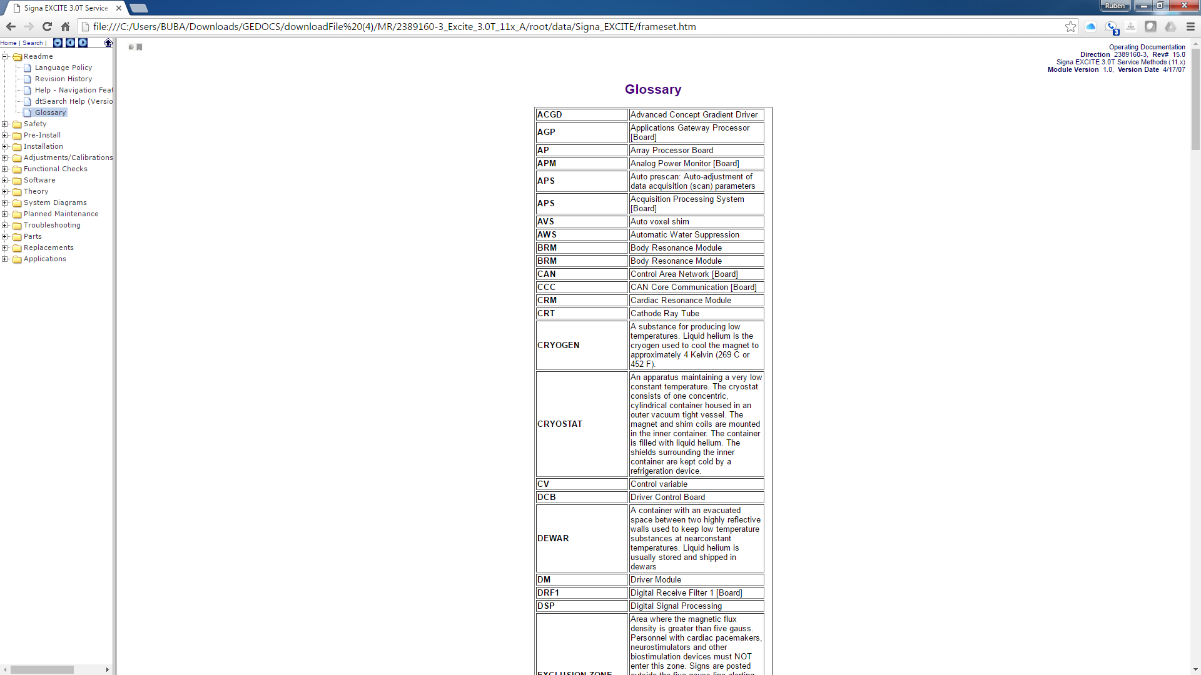
Service Documents
The Glossary will give you a list of acronyms in case you are curious to know what they stand for.

Slide 13
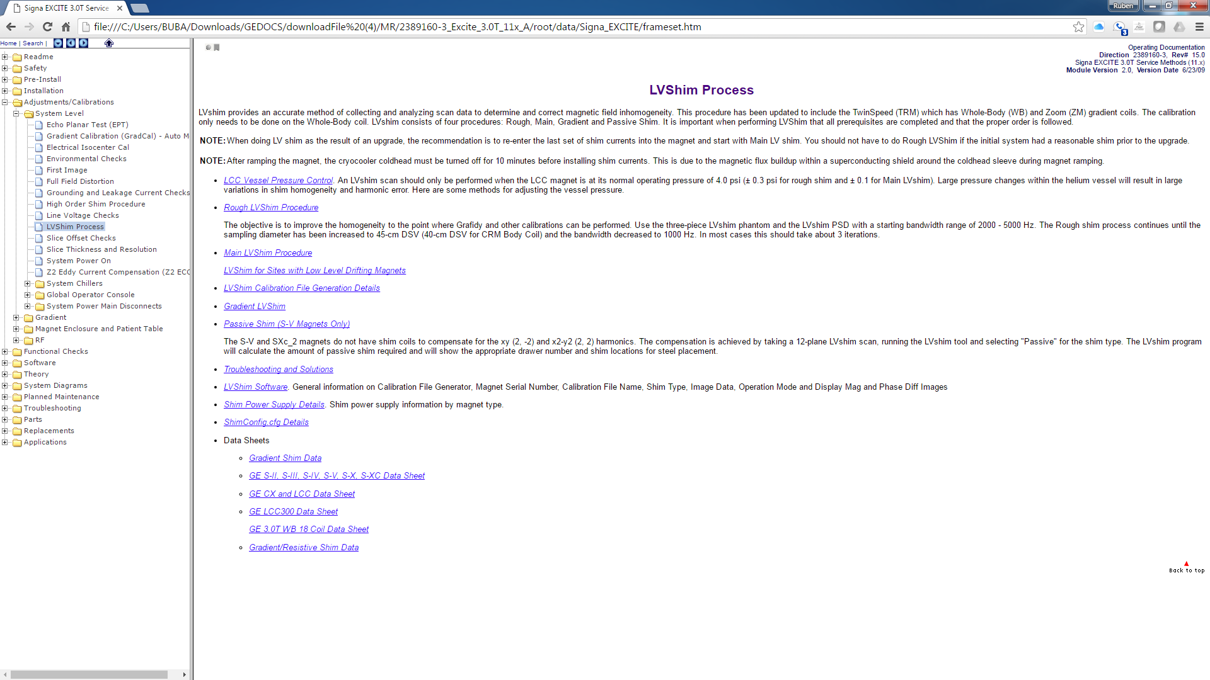
Service Documents
Under Adjustment/Calibrations we will find most of the instructions on how to run calibrations in a system. Keep in mind that some of them are taking right out from the proprietary CD and they do not work exactly the same. Many of the mechanical adjustments can be found here too.

Slide 14
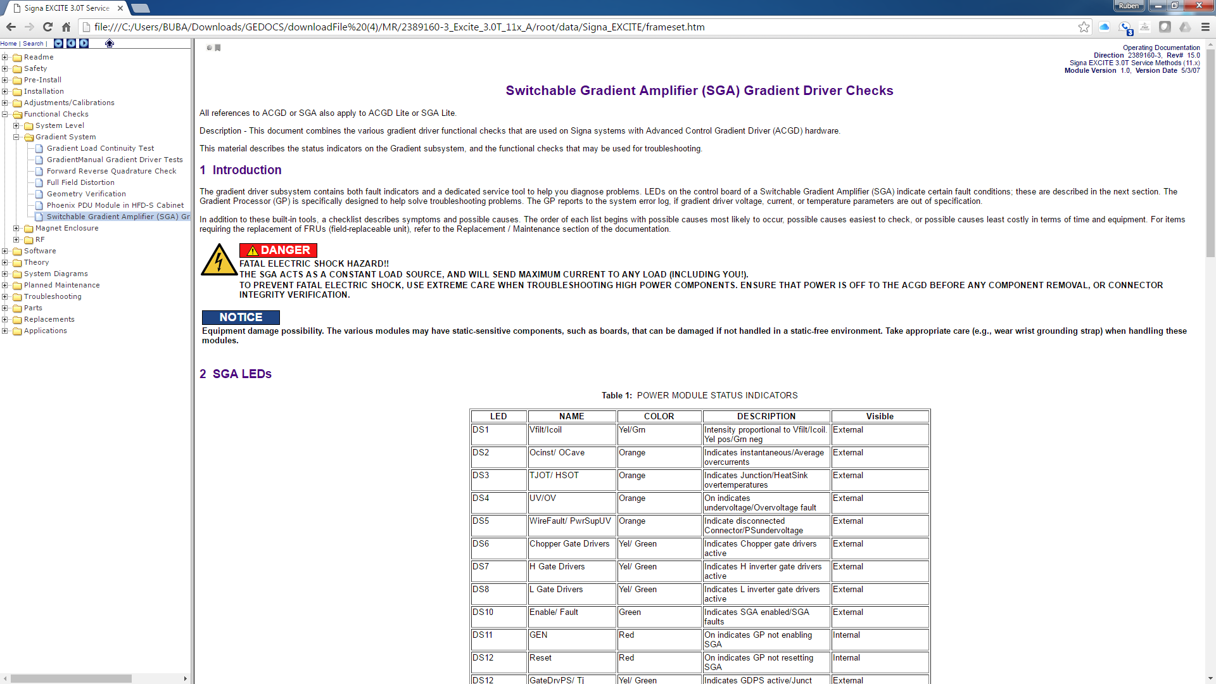
Service Documents
Functional checks has some repeat information from Calibrations but there are some good documents on checks that can be performed.

Slide 15
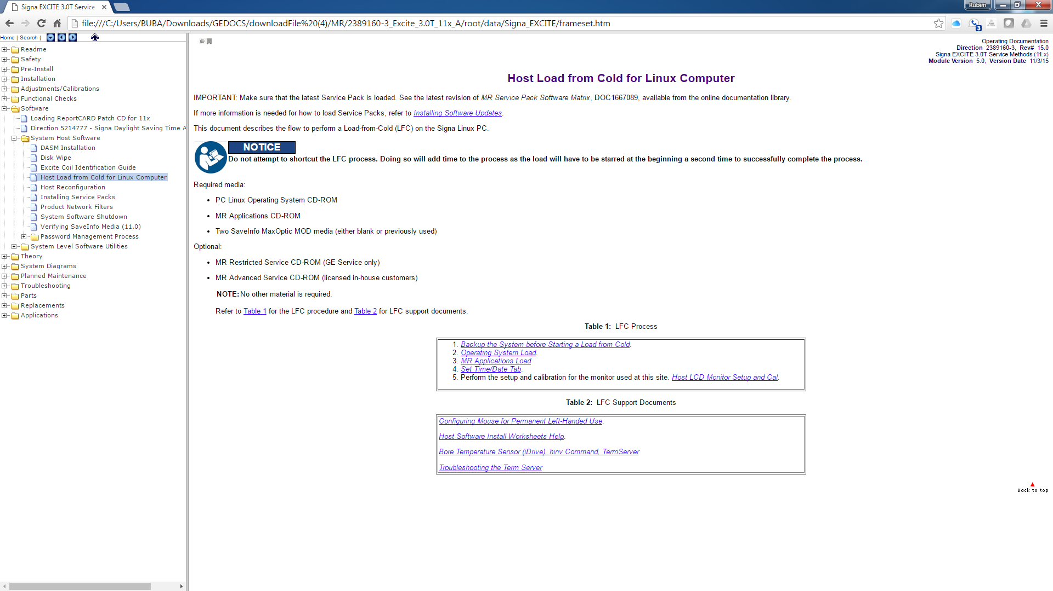
Service Documents
Software tab is everything related to the software in the console. Load from cold it is the most used here to reload the host software.

Slide 16
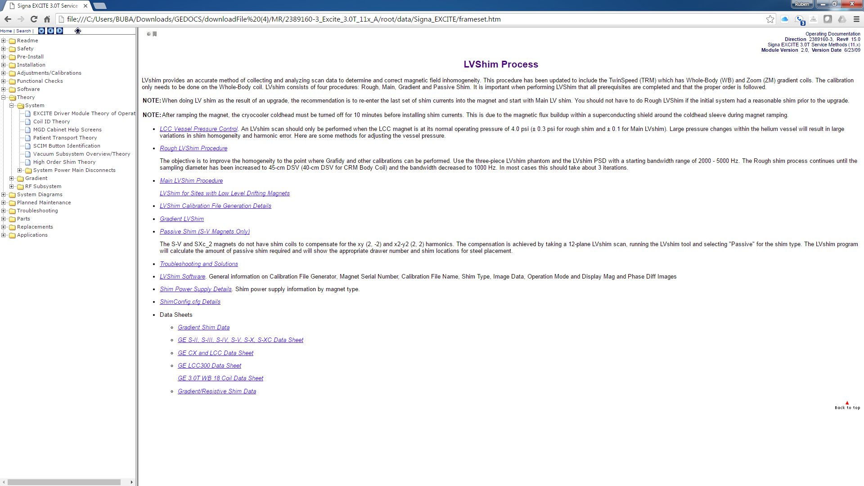
Service Documents
Theory is a great place to read on some of the major components from the MR. Even though GE has been putting less here in the newer systems, you can still find it in older systems on modules that are used in the newer MR platforms.

Slide 17
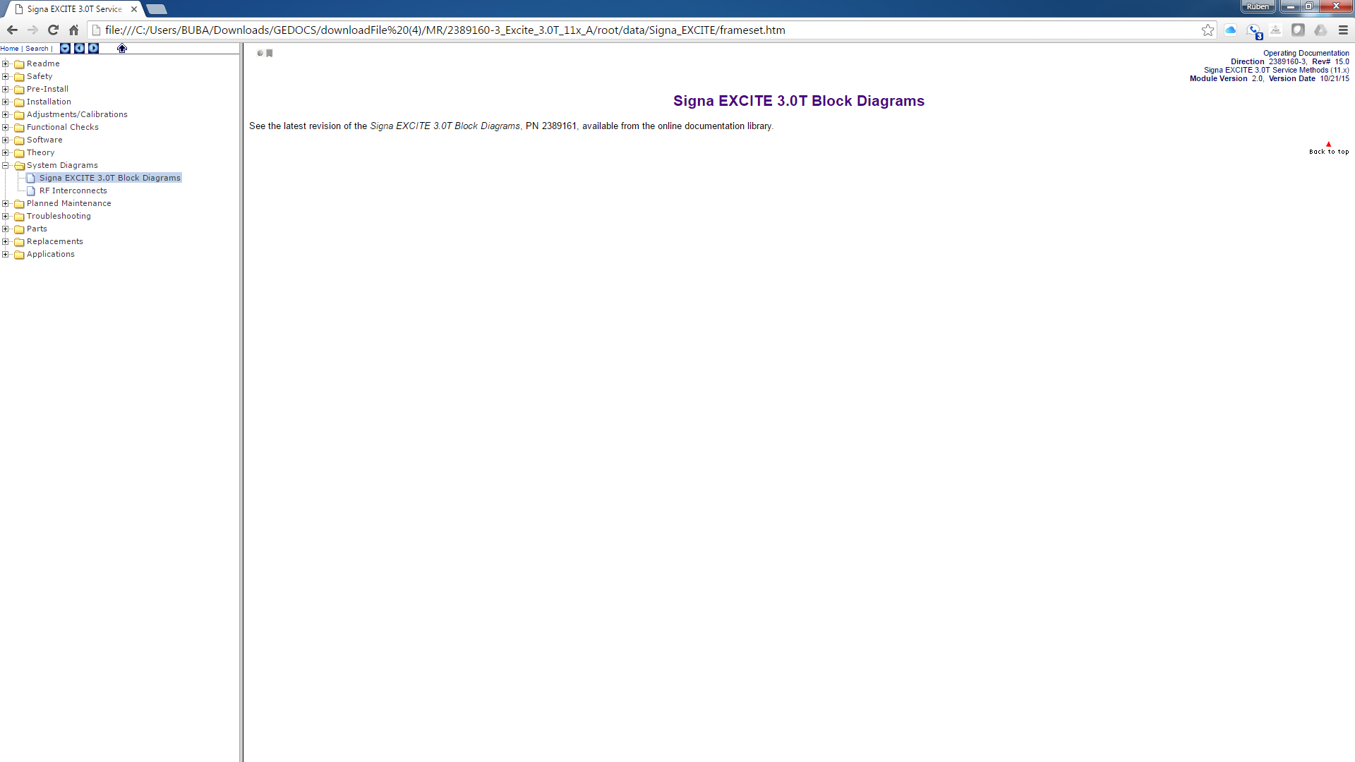
Service Documents
System diagrams have been disappearing out of here too. You can find some good diagrams in the older systems. Some PDFs with diagrams can be found in the CDL website

Slide 18
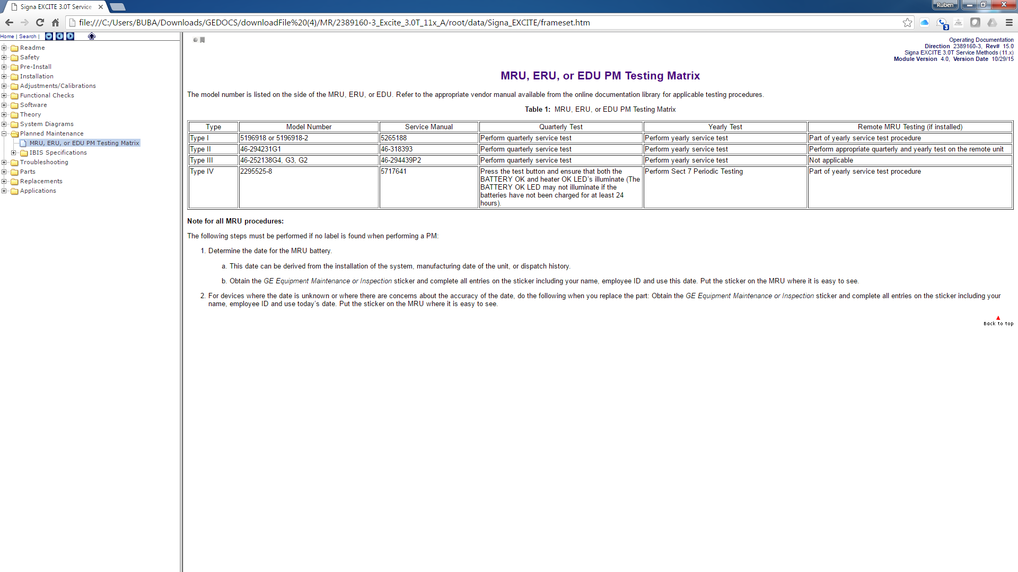
Service Documents
PM checks, schedule for when they should be done.

Slide 19
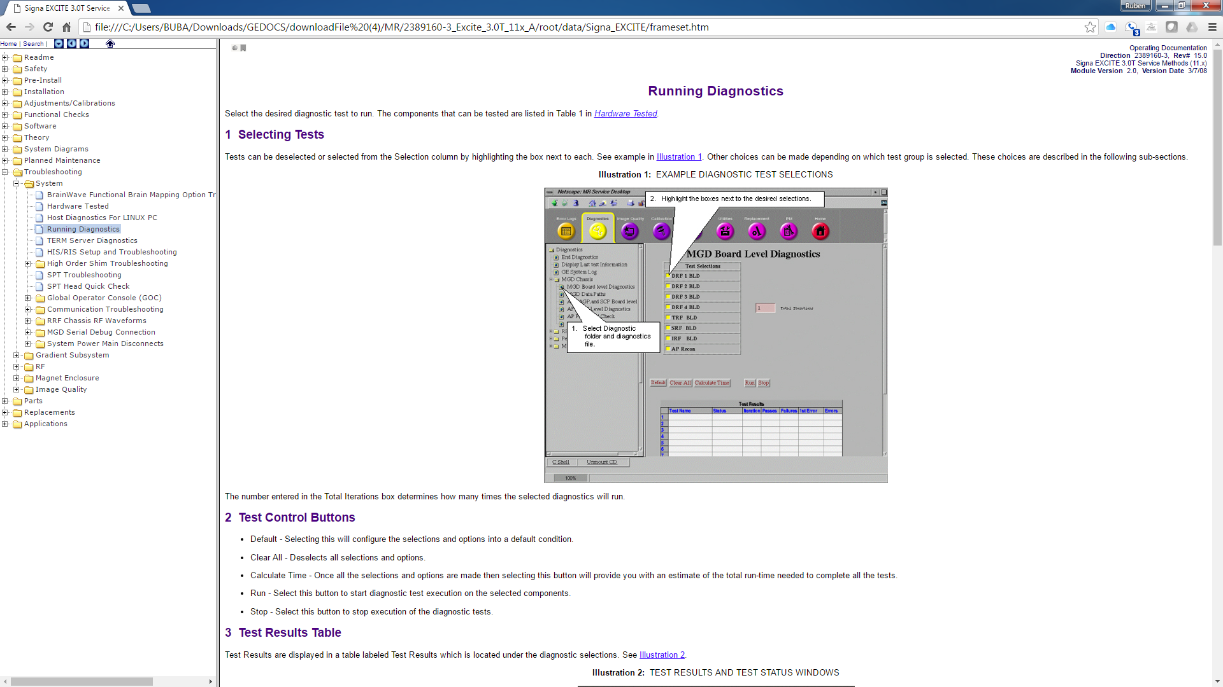
Service Documents
Troubleshooting might be a bit slim too but some good info can be found and some of the diagnostics in the service browser run also without a service key. There are big differences depending in the software level.

Slide 20
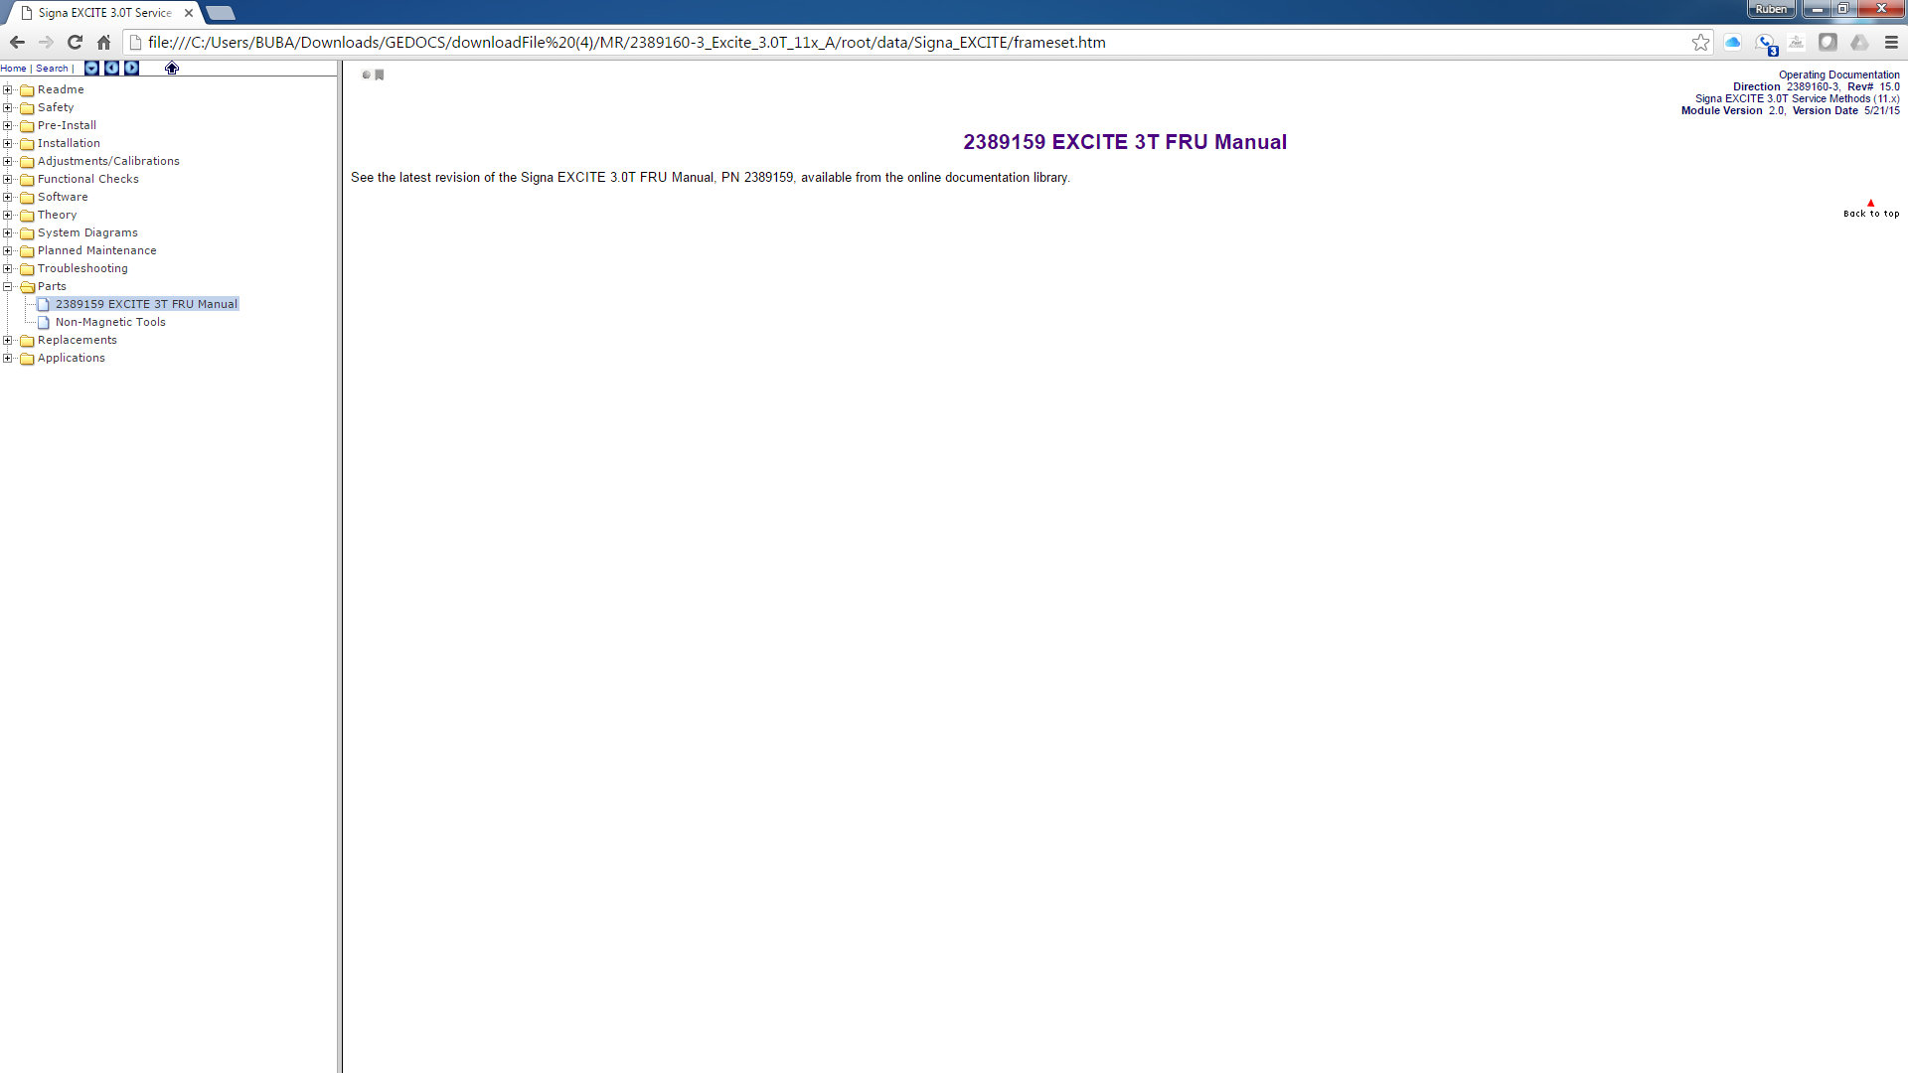
Service Documents
Parts were here. If not, then download the parts manual separately. Older revisions had it in this tab. If you have older revisions, don’t delete them. Keep them both.

Slide 21
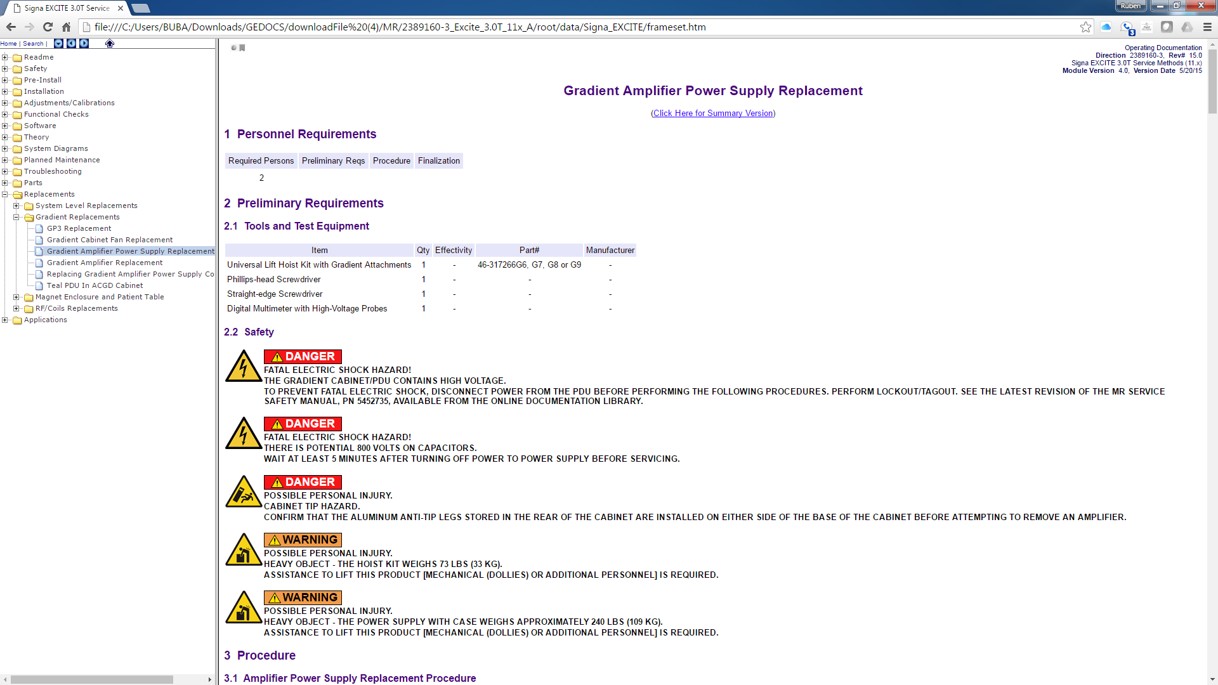
Service Documents
They usually give you quite a bit of replacement information, specially about the parts that have more safety issues involved.

Slide 22
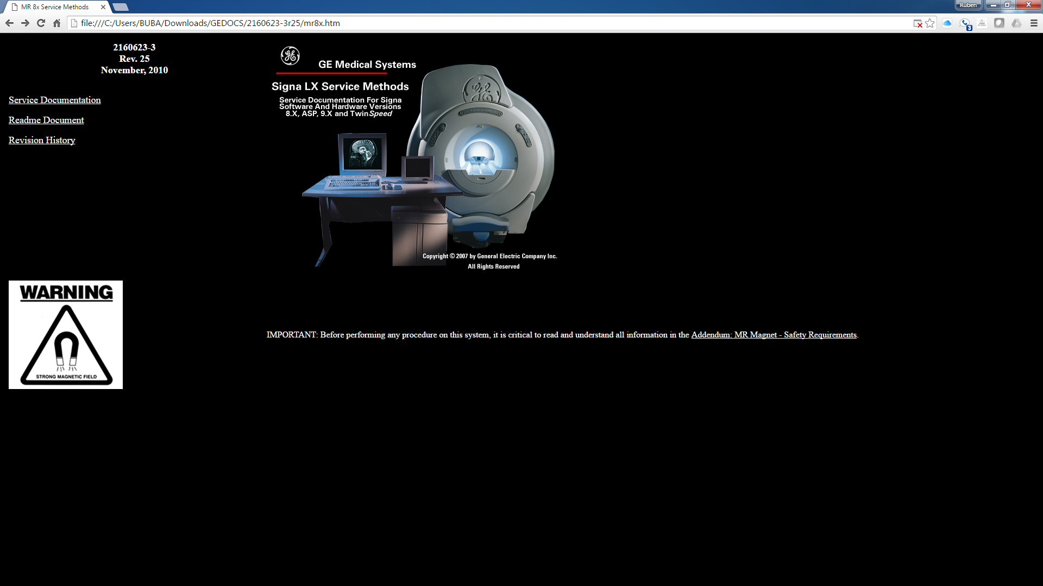
Service Documents

Slide 23
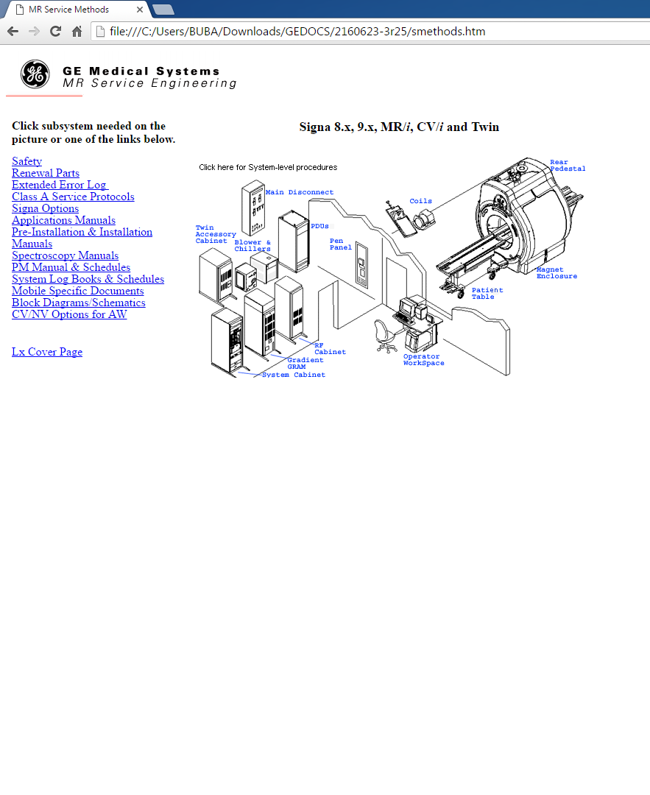
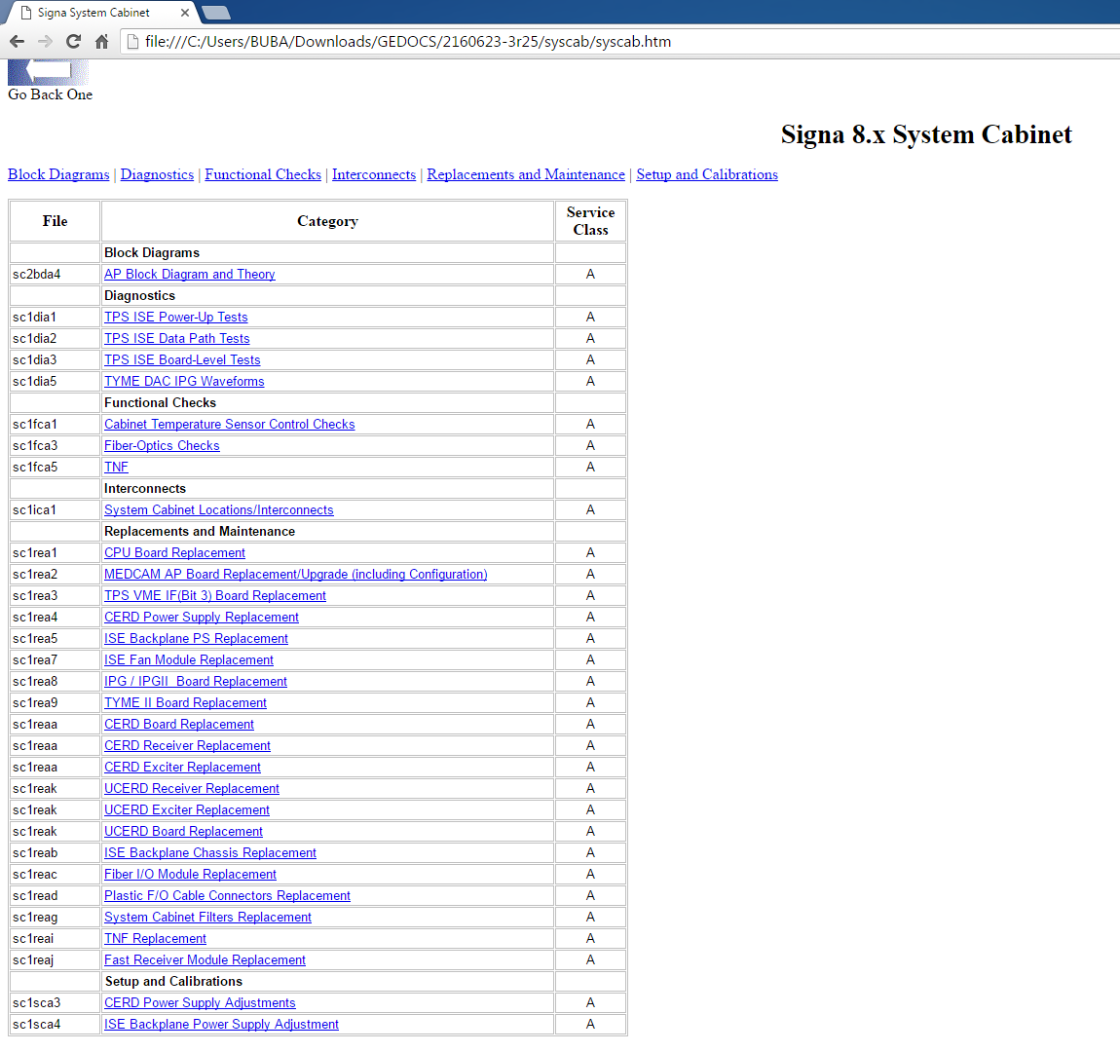
Service Documents
Things are organized a little different but same concept. Under each component you will find the adjustments, checks, troubleshooting and anything related to its components.

Slide 24
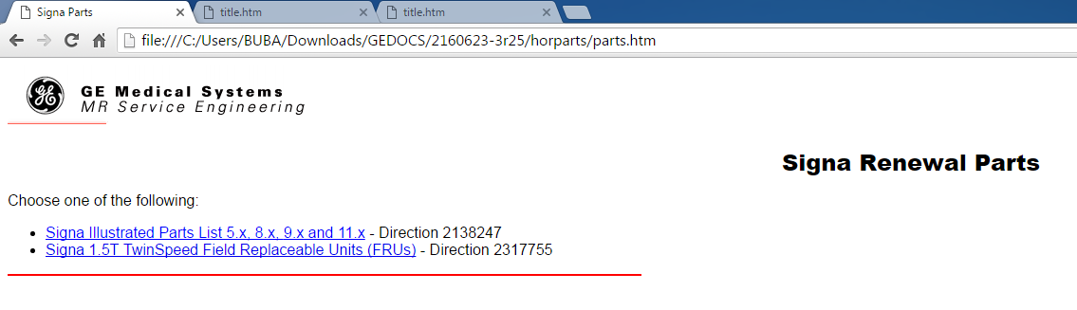
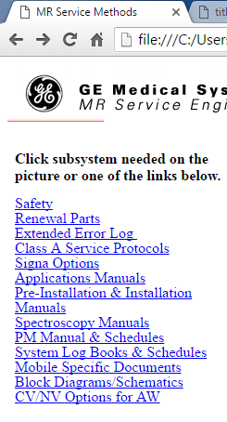
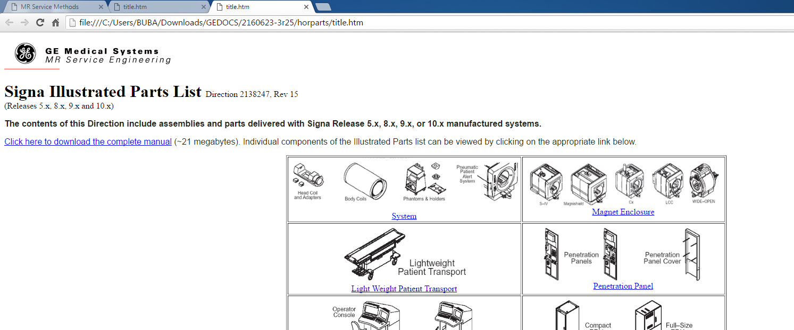
Service Documents
Parts manual can be located under the Renewal parts. It opens another window.
Select the one on the top
You can either download the full pdf manual or locate it by its location in the system

